Slide 1
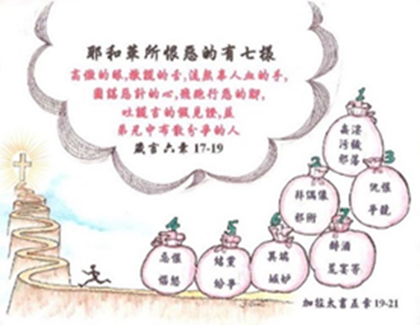
突破一切的攔阻
Mission Breakthrough
羅馬書15:18-19
孫雅各 牧師
10/20/2024
Romans 15:18-19
Rev. James Sun
10/20/2024

Slide 2
唯有神可賜下宣教的突破
Only God can give the mission breakthrough
除了基督藉我作的那些事、我甚麼都不敢題．只題他藉我言語作為、用神蹟奇事的能力、並聖靈的能力、使外邦人順服．甚至我從耶路撒冷、直轉到以利哩古、到處傳了基督的福音。 (羅15:18-19)
I will not venture to speak of anything except what Christ has accomplished through me in leading the Gentiles to obey God by what I have said and done. By the power of signs and wonders, through the power of the Spirit of God. So from Jerusalem all the way around to Illyricum, I have fully proclaimed the gospel of Christ. (Romans 15:18-19)

Slide 3
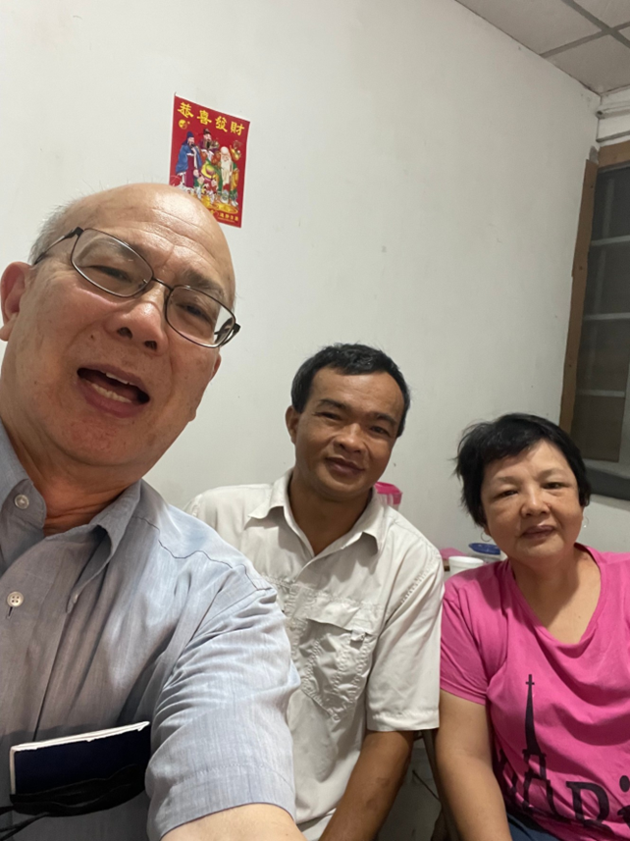
突破一切的攔阻
Mission Breakthrough
一、為何要參與宣教?
二、為何要參與短宣?
三、如何邁出第一步?
四、你願參與短宣嗎?
1. Why Mission?
2. Why Short Term Mission?
3. How to take the first Step?
4. Are you willing to take a short mission trip?

Slide 4
宣教向發展中地區轉移
Mission movement shifted to Global South

Slide 5
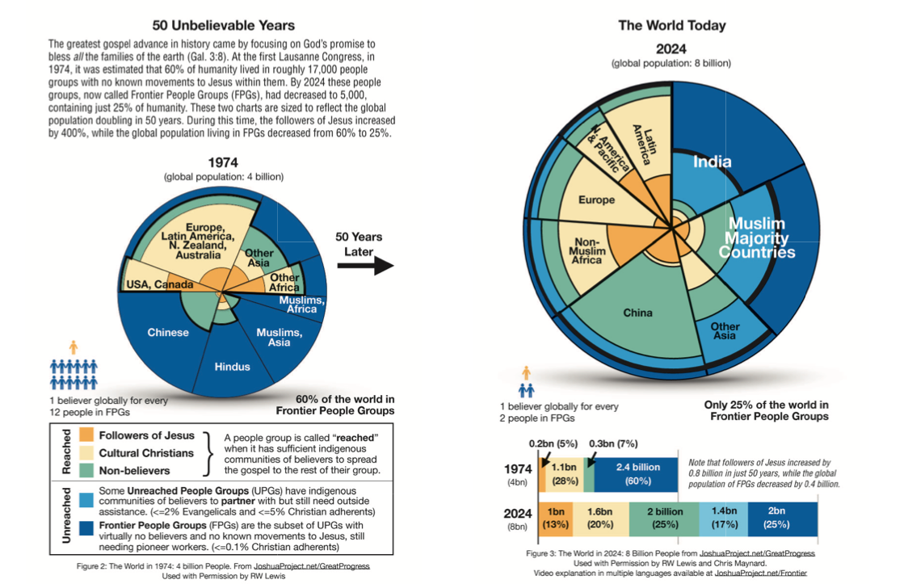
五十年來宣教的趨勢
50 Unbelievable Years of Mission progress
Source: Joshua Project – Great Progress

Slide 6
Future of Missions is … 宣教的未来
順應國度轉化的宣教
Mission as Kingdom Transformation
後西方 Post Western
本土化 Indigenous
整體性 Integral
接待性強的 Hospitable
多中心，從每個人到每個地方 Polycentric, from everyone to everywhere
Source: Daniel Low 劉浩宇博士
Excerpted from Johnson, T. (2024) The Future of Missions is Global (Keynote Address EMS National Conference 2024, Dallas, TX)

Slide 7
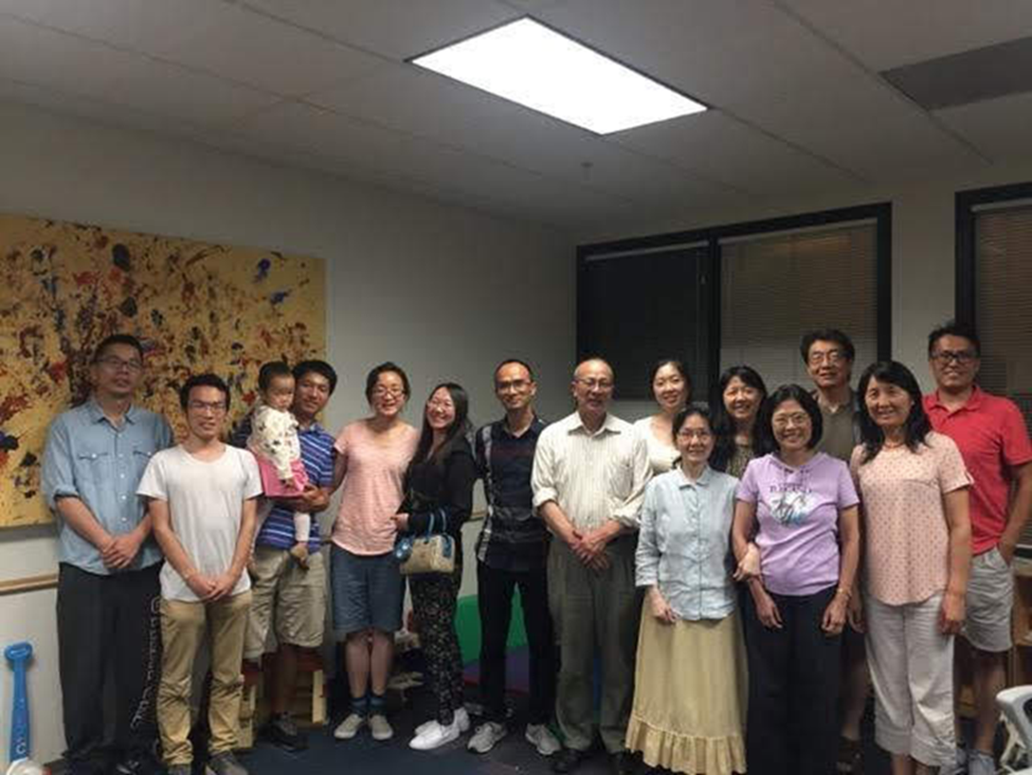
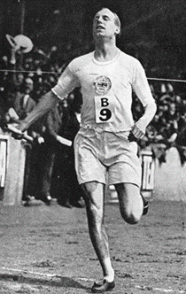
為何要參與宣教?
Why Mission?
1. 為何要參與宣教?
1. Why Mission?

Slide 8
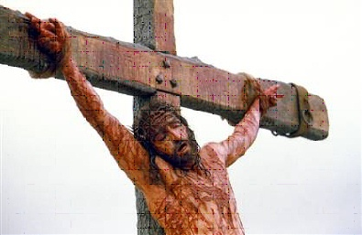
一、 為何要參與宣教?
1. Why Mission?
應許:遵守大使命得應許
順服:基督徒都應該參與
聽從:聖靈向等候的人說
心態:我們都欠福音的債
冠冕:為主而活的得勝者
興旺:教會得興盛的鑰匙
終局:福音傳到地極之時
Promise: Great Commission
Obedience: All Participation
Voice: Holy Spirit Articulation
Attitude: Debt Restitution
Crown: Overcomers’ Coronation
Revival: Church Revitalization
Eschatology: Final Destination

Slide 9
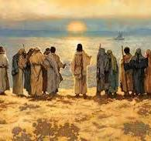
1. 應許:遵守大使命得應許
1. Promise: Great Commission
宣教是遵守基督頒布的大使命
耶穌進前來、對他們說、天上地下所有的權柄、都賜給我了。所以你們要去、使萬民作我的門徒、奉父子聖靈的名、給他們施洗．凡我所吩咐你們的、都教訓他們遵守我就常與你們同在、直到世界的末了。 (太28:18-20)
Mission is to obey Jesus’ great commission.
Then Jesus came to them and said, “All authority in heaven and on earth has been given to me. Therefore go and make disciples of all nations, baptizing them in the name of the Father and of the Son and of the Holy Spirit, and teaching them to obey everything I have commanded you. And surely I am with you always, to the very end of the age.” (Matthew 28:18-20)

Slide 10
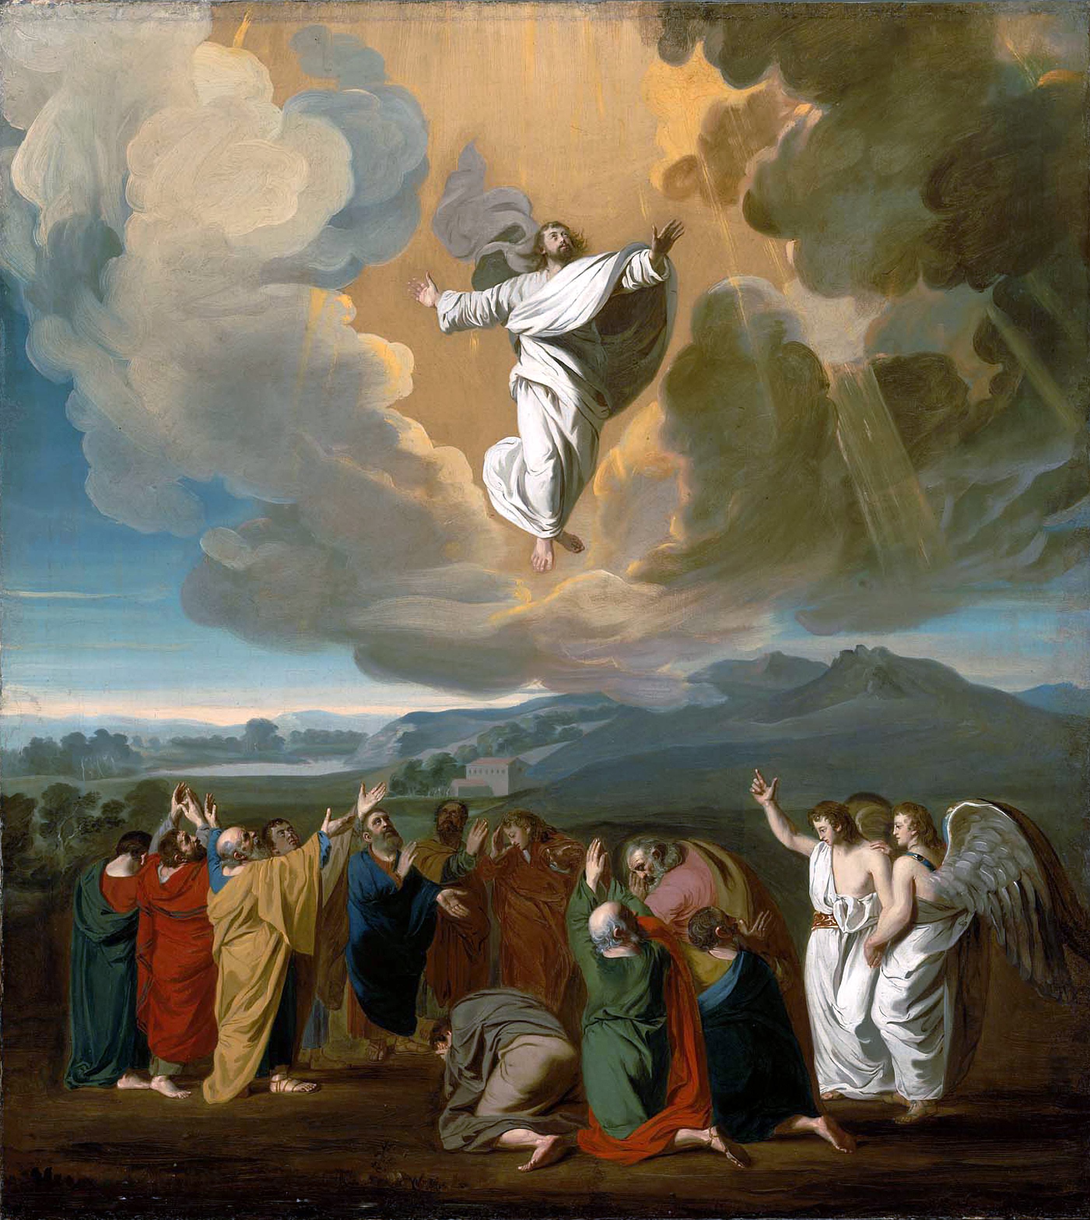
2. 順服:基督徒都應該參與
2. Obedience: All Participation
宣教是耶穌升天前對門徒的命令和應許。
但聖靈降臨在你們身上、你們就必得著能力．並要在耶路撒冷、猶太全地、和撒瑪利亞、直到地極、作我的見證。 (徒1:8)
Mission is the command and promise that Jesus gave to His disciples before His ascension.
But you will receive power when the Holy Spirit comes on you; and you will be my witnesses in Jerusalem, and in all Judea and Samaria, and to the ends of the earth. (Acts 1:8)

Slide 11
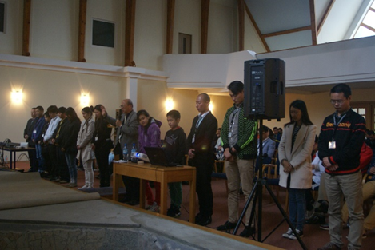
3. 聽從:聖靈向等候的人說
3. Voice: Holy Spirit Articulation
宣教是聖靈差遣門徒作神的工
他們事奉主、禁食的時候、聖靈說、要為我分派巴拿巴和掃羅、去作我召他們所作的工。(徒13:2-3)
Mission is Holy Spirit sent workers to do God’s work.
While they were worshiping the Lord and fasting, the Holy Spirit said, “Set apart for me Barnabas and Saul for the work to which I have called them.” So after they had fasted and prayed, they placed their hands on them and sent them off.(Acts 13:2-3)

Slide 12
4. 心態:我們都欠福音的債
4. Attitude: Debt Restitution
宣教士被差遣傳福音到福音尚未傳到的地方以致我們能悔改接受福音，我們有責任要還福音的債。
無論是希利尼人、化外人、聰明人、愚拙人、我都欠他們的債。(羅1:14)
Missionaries was sent by God to proclaim the gospel in the areas of not yet reached, so that we can hear the gospel and repented of our sins. Therefore, we are indebt to God and them, and obligate to share gospel.
I am obligated both to Greeks and non-Greeks, both to the wise and the foolish. (Romans 1:14)

Slide 13
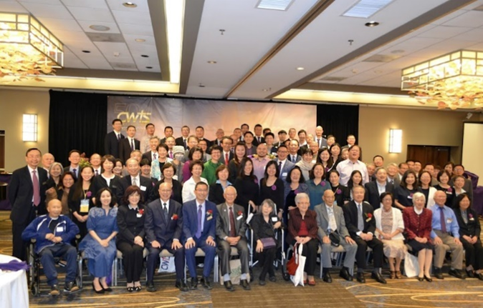
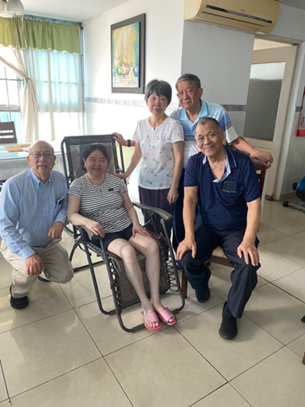
5.冠冕:為主而活的得勝者
5. Crown: Overcomers’ Coronation
願意付代價跟隨主的必得勝
羔羊是萬主之主、萬王之王．同著羔羊的、就是蒙召被選有忠心的、也必得勝。 (啟17:14)
whoever is willing to pay the price and follow the Lord will surely be among the overcomers.
They will wage war against the Lamb, but the Lamb will triumph over them because he is Lord of lords and King of kings—and with him will be his called, chosen and faithful followers. (Revelation 17:14)

Slide 14
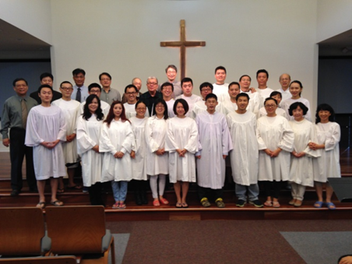
6. 興旺:教會得興盛的鑰匙
6. Revival: Church Revitalization
安提阿教會是一間宣教的教會，福音興盛在安提阿。
但內中有居比路、和古利奈人、他們到了安提阿、也向希利尼人傳講主穌穌。主與他們同在、信而歸主的人就很多了。 (徒11:20-21)
Antioch church did mission which led to gospel revival.
Some of them, however, men from Cyprus and Cyrene, went to Antioch and began to speak to Greeks also, telling them the good news about the Lord Jesus. The Lord's hand was with them, and a great number of people believed and turned to the Lord. (Acts 11:20-21)

Slide 15
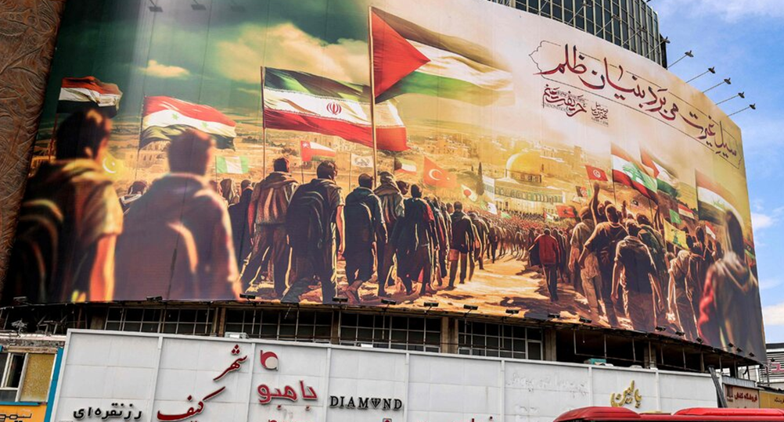
7. 終局:福音傳到地極之時
7. Eschatology: Final Destination
神的旨意必定完成。父神賜給耶穌的人一個也不會失落。(約6:39)
這天國的福音、要傳遍天下、對萬民作見證、然後末期才來到。 (太24:14)
And this is the will of him who sent me, that I shall lose none of all those he has given me, but raise them up at the last day. (John 6:39)
And this gospel of the kingdom will be preached in the whole world as a testimony to all nations, and then the end will come. (Matthew 24:14)

Slide 16
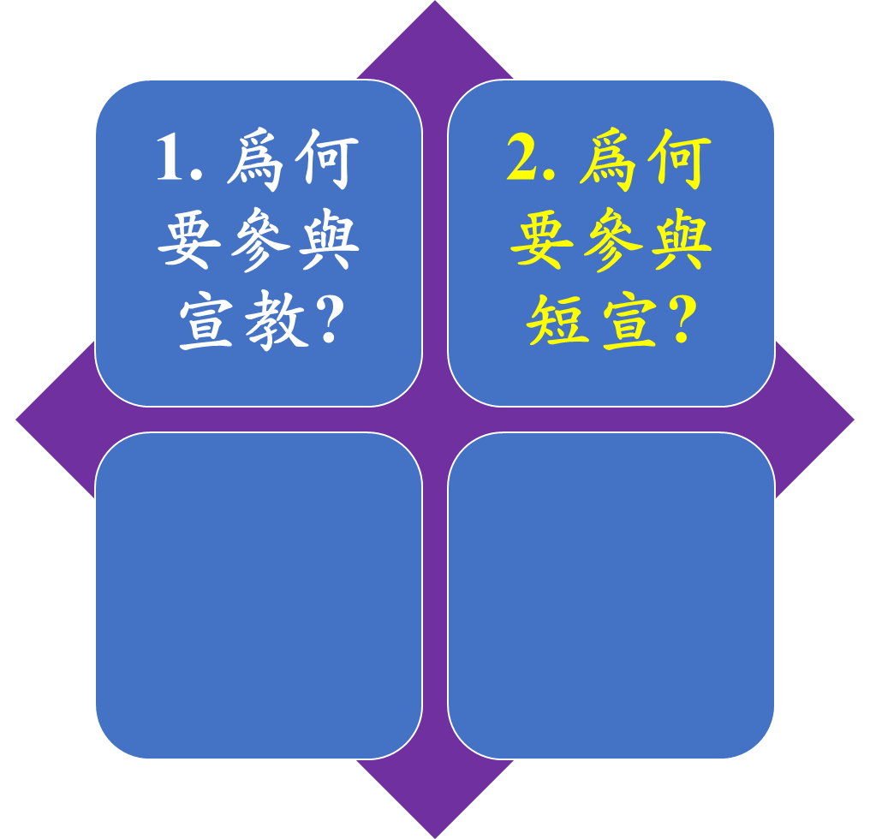
為何要參加短宣?
Why Short Term Mission?
1. Why Mission?
2. Why Short Term Mission?

Slide 17
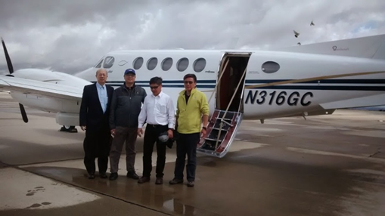
二、 為何要參與短宣?
2. Why Short Term Mission?
1. Shortage of career missionaries
2. Missionaries needs co-workers
3. Processes to become missionaries
4. Aware of the necessity of training
5. Help churches in mission fields
6. become workers without shame
7. Allow more people to be equipped
全職的宣教士極度的缺乏
宣教士需要委身的同工群
從短宣到長宣的探索過程
明白自己需要的全人裝備
幫助教會得著急需的支援
成為神可使用的無愧工人
讓更多的人得裝備和成全

Slide 18
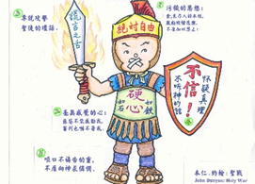
1. 全職的宣教士極度的缺乏
1. Shortage of career missionaries
宣教士的條件讓人望而卻步
諸般的限制:
年齡、家庭、經費、裝備、
經驗、恩賜、健康、呼召、
護照、差會、語言、
適應、心志、能力、
婚姻、退休。
The qualification of missionary too high
Restrictions:
age、family、financial 、training、experience、gifts、health、calling、
visa、mission organization、language、flexibility、strength、 strength 、marriage、retirement.

Slide 19
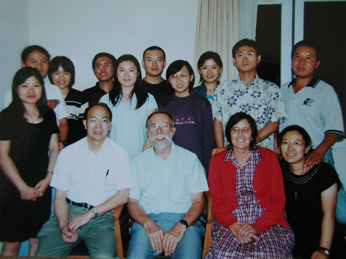
2. 宣教士需要委身的同工群
2. Missionaries needs co-workers
宣教士最大的挑戰是孤軍奮戰
迫切需要短宣的支援:
有好品格的同工
恩賜配搭的朋友
願意接棒的領袖
謙卑勞苦的僕人
The highest challenge is facing battle alone
Desperately need true supports:
a) Co-worker with good character
b) Partner friends with spiritual gifts
c) Desire to learn to be future leaders
d) Willing to be humble servant leaders

Slide 20
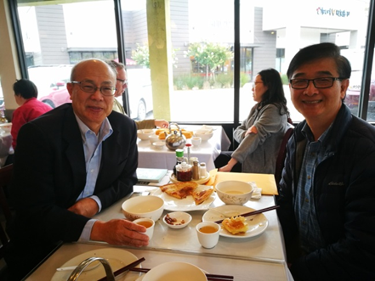
3. 從短宣到長宣的探索過程
3. Processes to become a missionary
短宣的體驗帶進長宣的可能
順服聖靈的感動:
接受環境的鍛鍊
得到敬虔的操練
挑旺屬靈的恩賜
順服聖靈的感動
STM leads to missionary candidate
Be obedient to the calling of the Holy Spirit:
a) Endure trials
b) Exercise piety
c) Actualize gifts
d) Lead by Holy Spirit

Slide 21
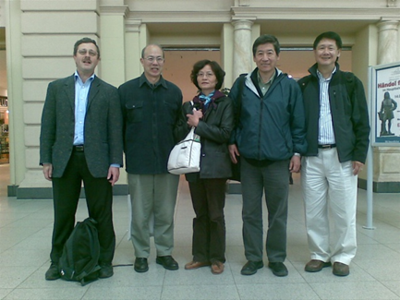
4. 明白自己需要的全人裝備
4. Aware of the necessity of training
宣教士是神忠心的僕人
彌補自己的不足:
聖經真道的裝備
與神交通的經歷
與人同工的藝術
栽培領袖的負擔
Special calling to be a faithful servant
Strengthen the weak links:
a) Biblical foundation
b) Communion with God
c) Personal and communication skills
d) Burden and knowledge in raising leaders

Slide 22
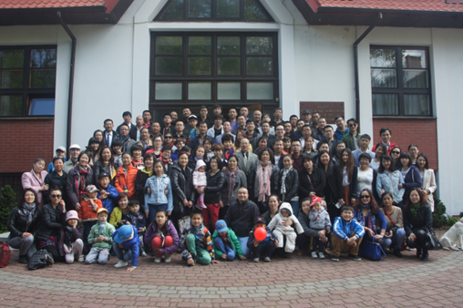
5. 幫助教會得著急需的支援
5. Help churches in mission fields
短宣教幫助弱小教會成長
經歷神同在的應許:
栽培神國的人才
與神同工的原則
豐盛供應的經歷
榮神益人的實際
Short term mission helps weak church to grow
Receive experience in God’s promises:
a) Raise emergent leaders in God’s Kingdom
b) Learn the principle of being God’s co-worker
c) Experience God’s bountiful supply
d) Become channel of God’s blessings to people

Slide 23
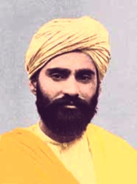
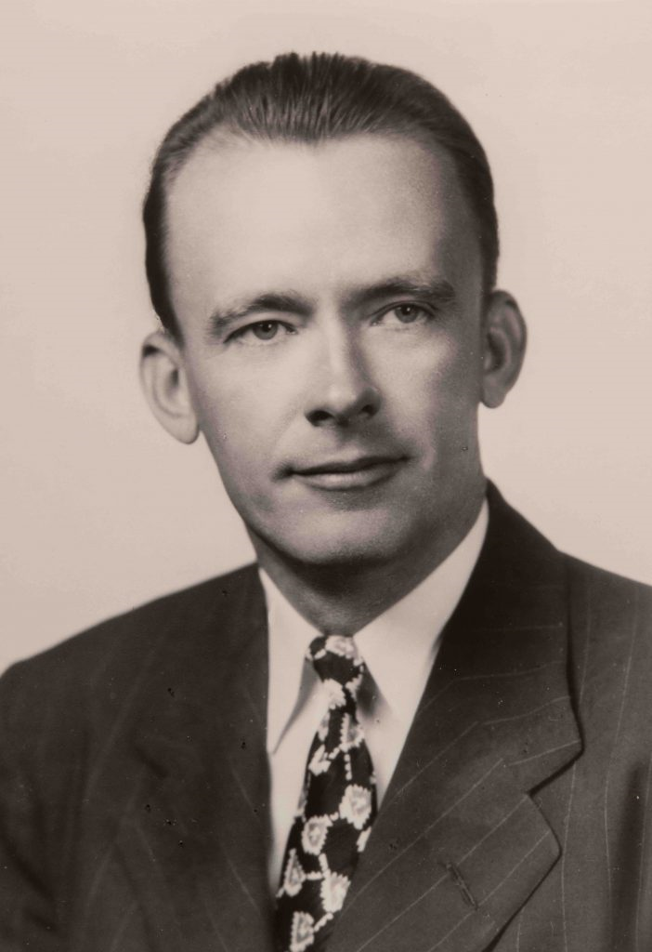
6. 成為討神喜悅的無愧工人
6. become workers without shame
立志討主的喜悅。 (林後5:9)
在神家作忠心有見識的僕人:
效法基督的捨己
不求回報的付出
忠於託付的僕人
為主而活的榜樣
Make it our goal to please him (2 Corinthians 5:9)
Be a faithful servant with wisdom:
a) Imitate Christ’s sacrificial giving
b) Give without anticipating any return
c) Faithful to what was entrusted by God
d) Become a role model for other servants
西藏宣教士
印度聖徒
孫大信
Missionary from India to Tibet Sundar Singh
廣西宣教士
華勒斯醫生
Missionary from
US to Guangxi
Dr. Bill Wallace

Slide 24
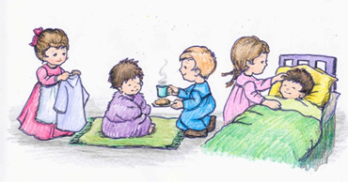
7. 讓更多的人得裝備和成全
7. Allow more people to be equipped
服事主凡事謙卑眼中流淚(徒20:19)
在神家作忠心有見識的僕人:
施比受更為有福 (徒20:35)
看別人比自己強 (腓2:3)
用恩賜彼此服事 (彼前4:10)
恭敬人彼此推讓 (羅12:10)
served with great humility and with tears. (Acts 20:19)
Become faithful and wise servant in God’s household.
a) More bless to give than to receive (Acts 20:35)
b) Consider others better than yourselves
(Philippians 2:3)
c) Offer hospitality to one another without
grumbling (1 Peter 4:9)
d) Be devoted to one another in love. Honor one
another above yourselves (Romans 12:10)

Slide 25
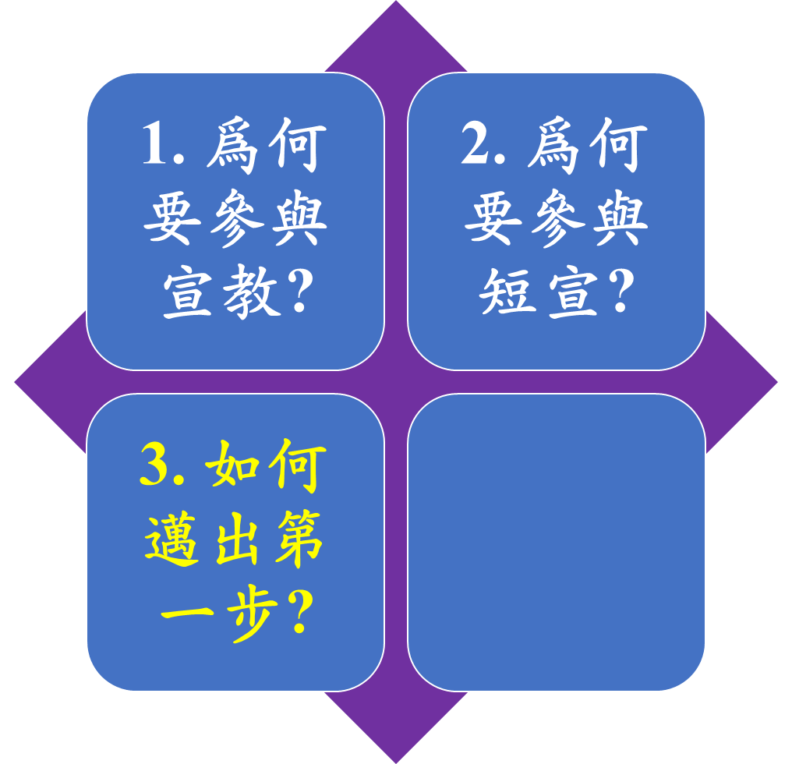
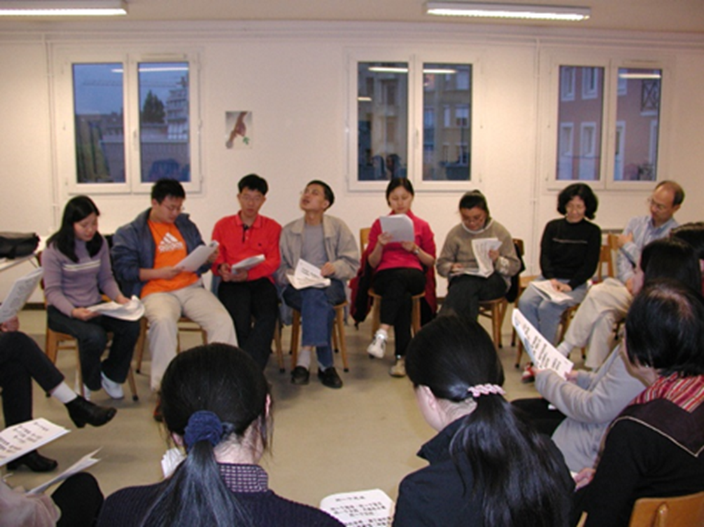
參與短期宣教
How to Take first Step?
1. Why is Mission important?
2. Why Short Term Mission?
3. How to Take first Step?

Slide 26
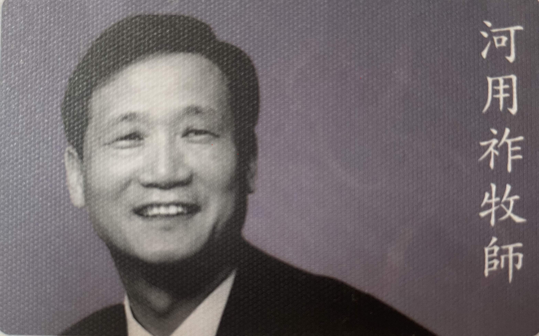
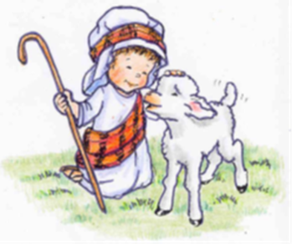
三、如何邁出第一步?
3. How to take the first step?
2023年翻譯成中文的夢想建立使徒行傳的教會的作者，韓國大地教會的河用祚牧師的第一步是全心認定宣教是向患有犯罪失憶症及信仰失憶症的人們傳福音宣告耶穌基督是全世界唯一的救主是教會在這地上最後的，也是最大的使命。
The founding pastor of Onnuri Community Church, and Duranno Father School, Rev. Yong Jo Ha wrote the Dream of building the church according to the New Testament book of Acts. This book is one of the most important books in the field of mission and evangelism has been translated to Chinese in 2023. The major Theme of this book is the reality of church growth through small cell groups according to the biblical principle, fervent prayer, and mission.

Slide 27
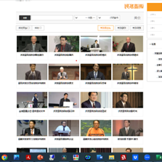
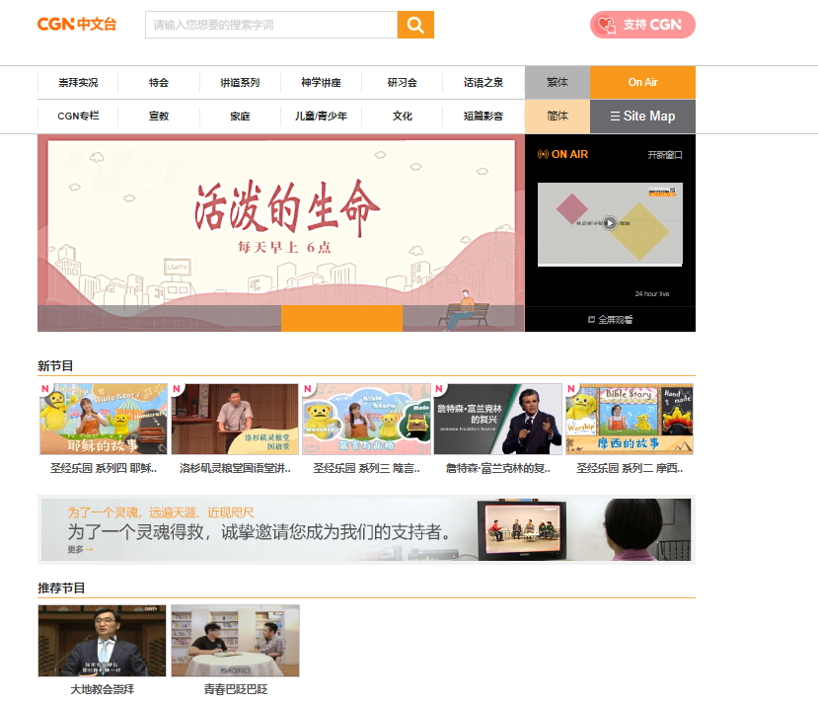
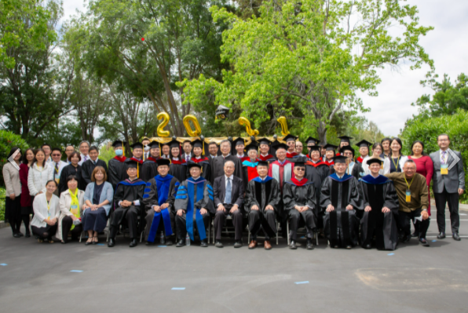
三、如何邁出第一步?
3. How to take the first step?

Slide 28
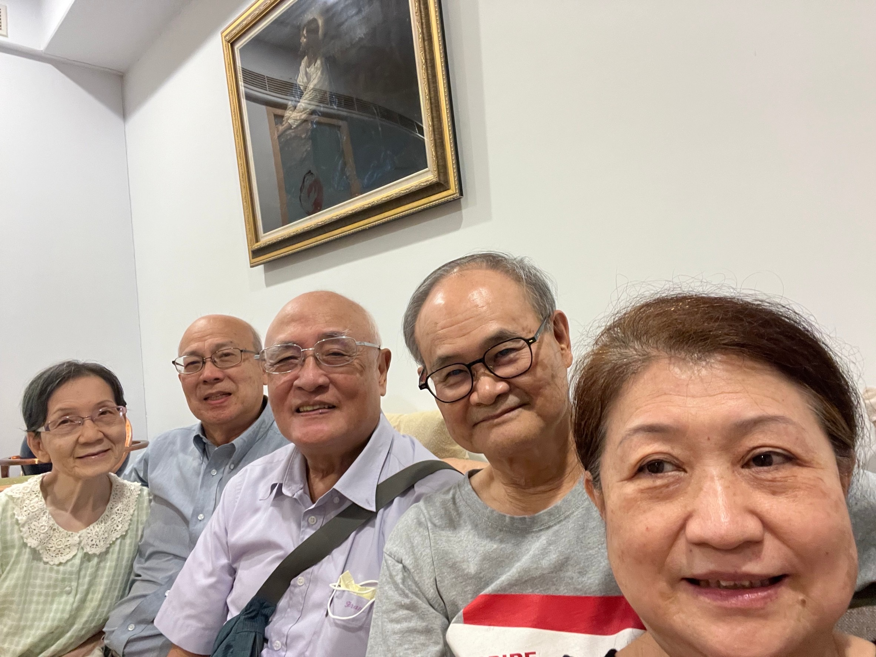
三、如何邁出第一步?
3. How to take the first Step?
1.滿懷宣教的異象
2.大地教會的房角石
3.宣教的果效來自神
4.使教會復興的秘訣就是宣教
5.走向未得之民的宣教
6. 宣告使徒行傳的異象
7. 成為一粒麥子 (約12:24)
1. Passion for mission with vision and action
2. Cornerstone of Onnuri Community Church
3. Fruit of mission from God only
4. The secret for church growth is mission
5. Movement of reaching the unreached
6. Proclaim the vision of Acts continuing
7. A kernel of wheat died to produce many seeds

Slide 29
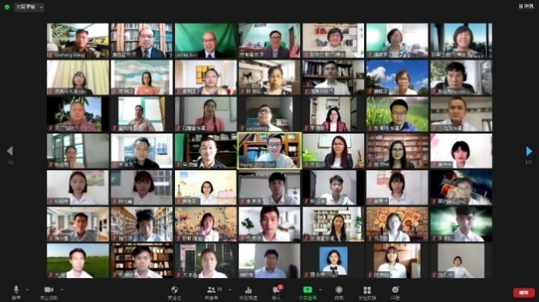
1. 滿懷宣教的異象
1. Passion for mission with vision and action
教會初創12個家庭，人數不到一百人就向神求兩千年輕人，三百位精兵，好讓教會能將人獻到主的面前。垂聽禱告的神在大地教會創會七年後，有兩千年輕人，又過了14 年，有一萬名青年。
A 12 families in a church with less 100 congregation asked God to give 2000 young people, and three hundred warriors to lead lost souls to the Lord. God answered their prayer. Within 7 years, 2,000 young people came. After 14 years, 2,000 turned to 10,000.

Slide 30
1. 滿懷宣教的異象(續)
1. Passion for mission with vision and action
過了23年，2007已經超過兩萬青年，差派遣宣教士2,145人，差遣國家達77個。
異象帶動教會復興風潮。
這些宣教士大部分都從帶職的短宣開始。
23 years later, the church has more than 20,000 young peole, sending 2,145 missionaries to 77 countries in 2007.
Vision indeed brought church revival.
Most of those missionaries started with bi-vocational.

Slide 31
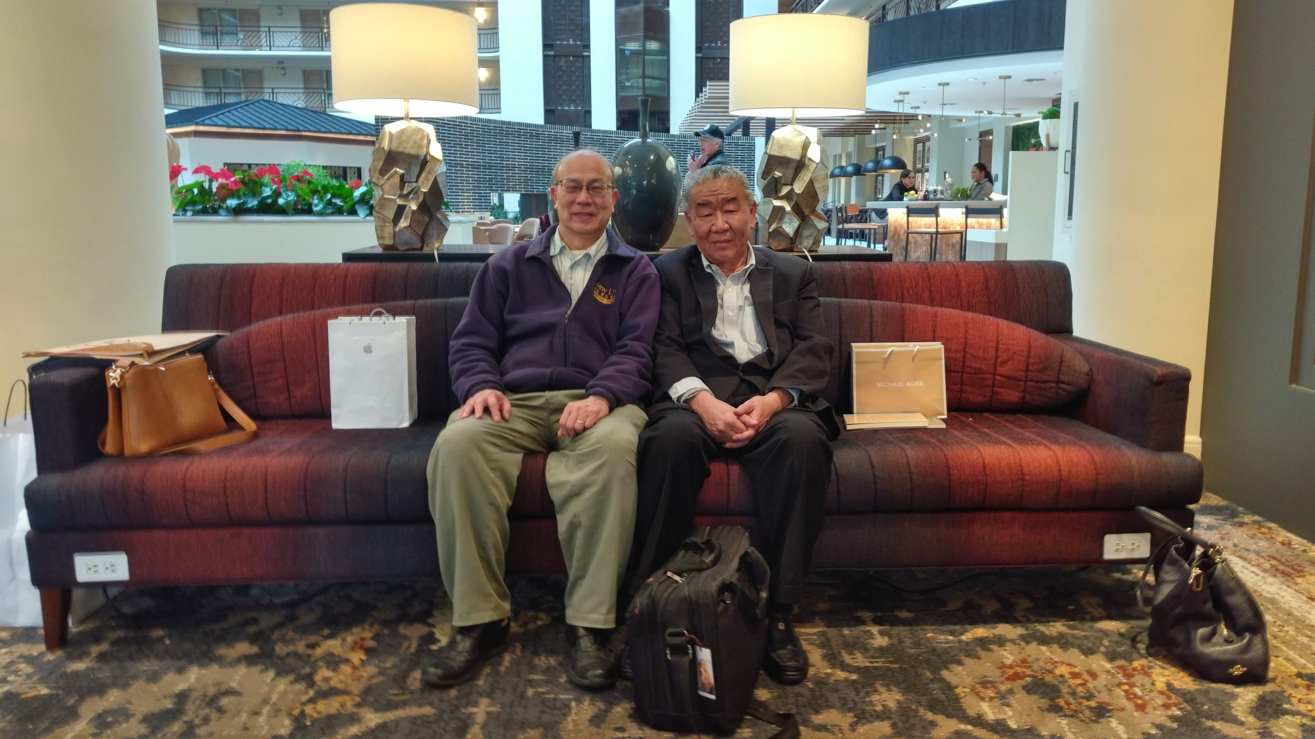
2. 大地教會的房角石
2. Cornerstone of Onnuri Community Church
四福音的總結(太28:19,可16:15,路24:48,約21:16- 17)
使徒行傳的開頭(徒1:8)
宣教就是得著權柄向未曾聽見福音或是不可能聽見福音的其他民族獻上自己傳耶穌基督的福音。
Four gospel concluded such mission endeavor. (Matthew 28:19, Mark 16:15, Luke 24:48, John21:16-17) The beginning of Acts also started with such mission movement. (Acts1:8)
Mission is to receive power to proclaim gospel to those people groups who have never heard about gospel, so that they were transformed and share gospel of Jesus Christ themselves.

Slide 32
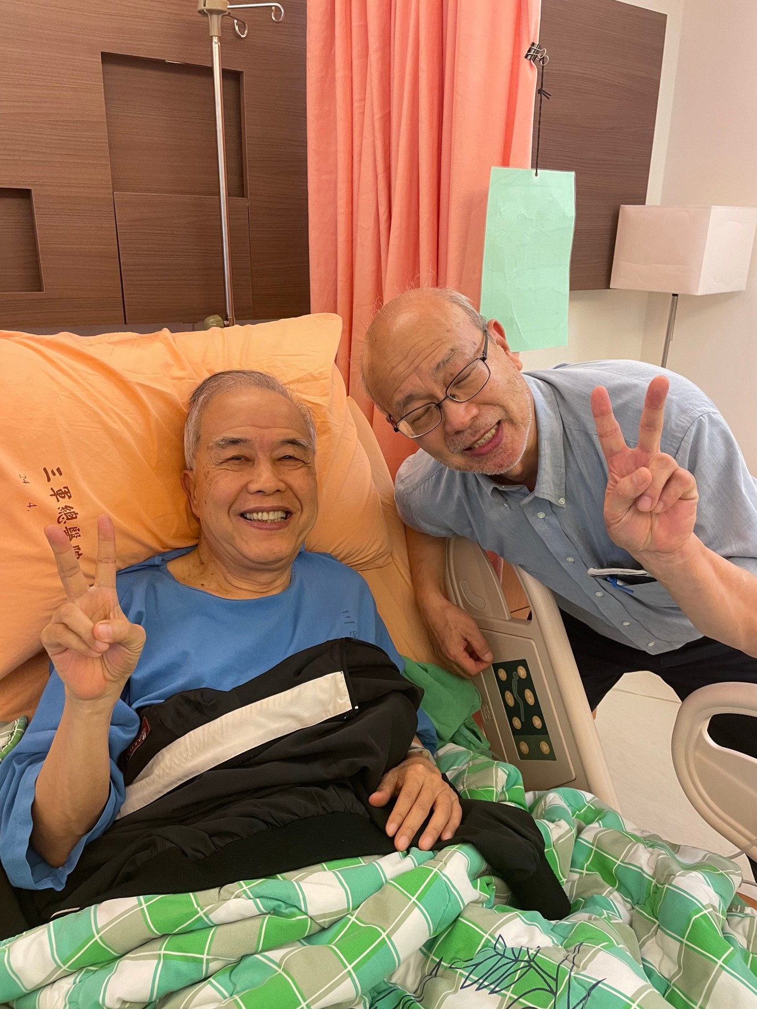
3. 宣教的果效來自神
3. The fruit of Mission comes from God
透過信心和順服讓聖靈使用我們這些卑微的人。
耶穌是教會的頭，是教會的主任牧師，是長老會的會長，是一切團契的帶領者。
The Holy Spirit will use those humble people who have faith in God, and obey Him.
Jesus is the head of the church, who is the senior pastor, the chairman of the elder board, leader of all the fellowship groups.

Slide 33
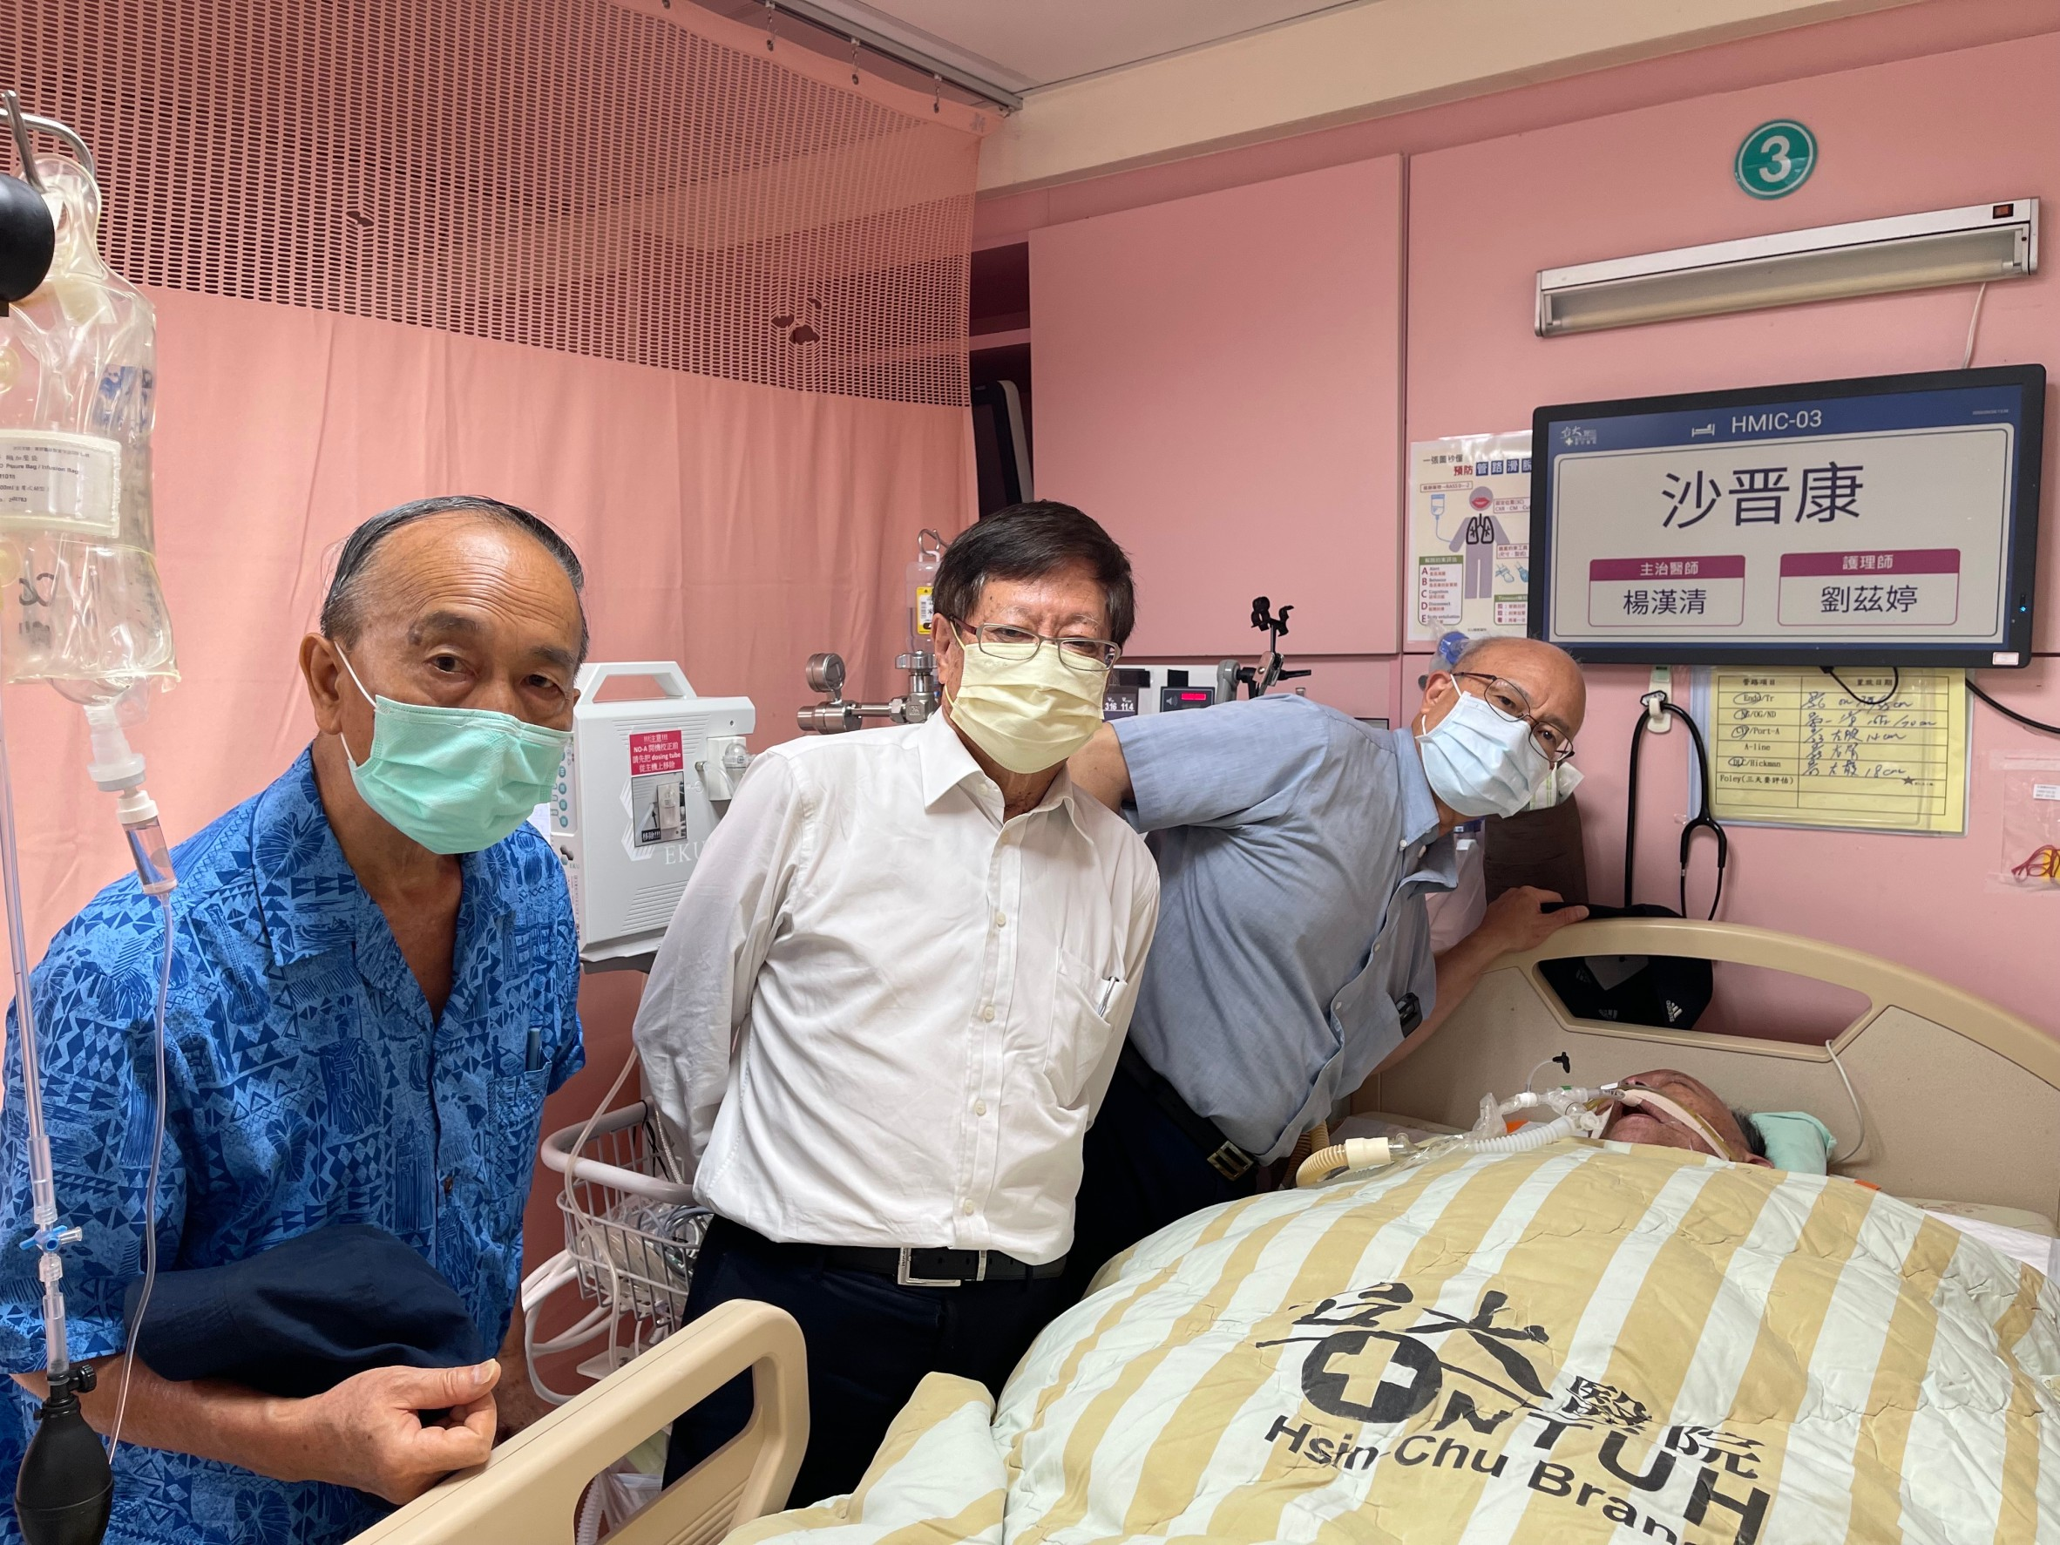
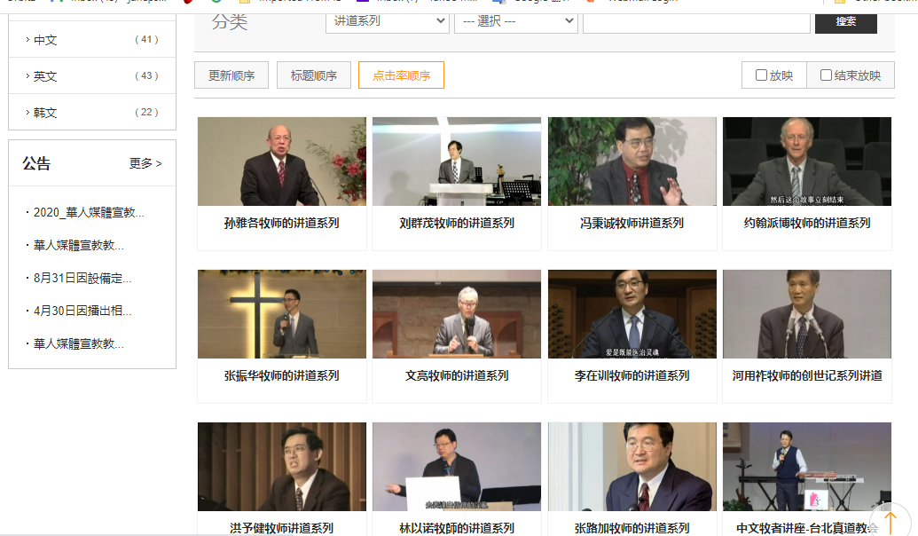
4. 使教會復興的秘訣就是宣教
4. The secret for church growth is mission
真教會全力以赴將福音傳到未得之地。
他們立志盡他們的力量擺上金錢和資源，廣傳福音，2006年10月成立日本CGN TV，2008年6月在台灣成立CGNTV中文台。
True church will do the best to share gospel to the unreached people groups.
Onnuri Community Church shared all their resources for mission. In October 2006 they started Japan CGNTV. In June 2008 CGNTV Chinese Broadcast was established in Taiwan.

Slide 34
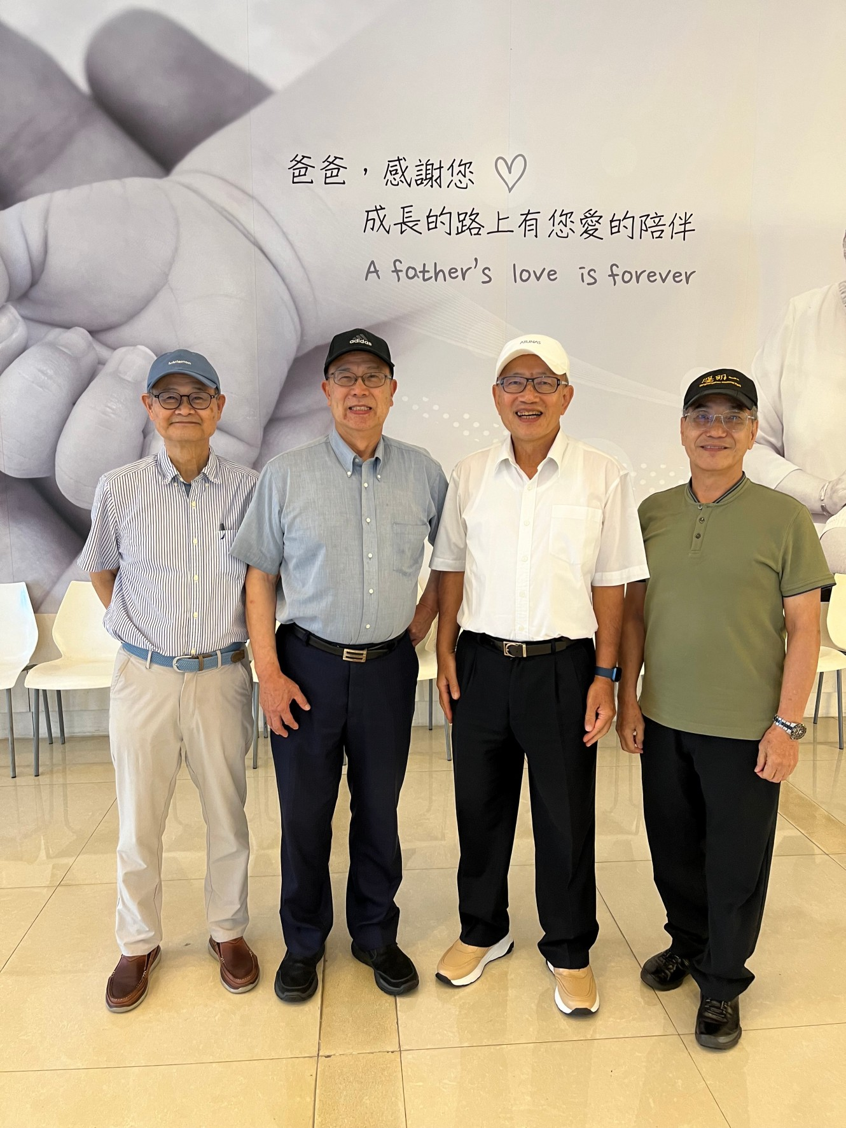
5. 走向未得之民的宣教
5. Mission to the unreached People
大地教會認領了八個未得之民，後來到增長到十五個未得之民。
他們認定天國的福音要傳遍天下，對萬民作見證，然後末期才來到。(太24:14)
Onnuri Community Church in Korea increased the unreached people groups from 8 to 15.
They firmly believe this gospel of the kingdom will be preached in the whole world as a testimony to all nations, and then the end will come. (Matthew 24:14)

Slide 35
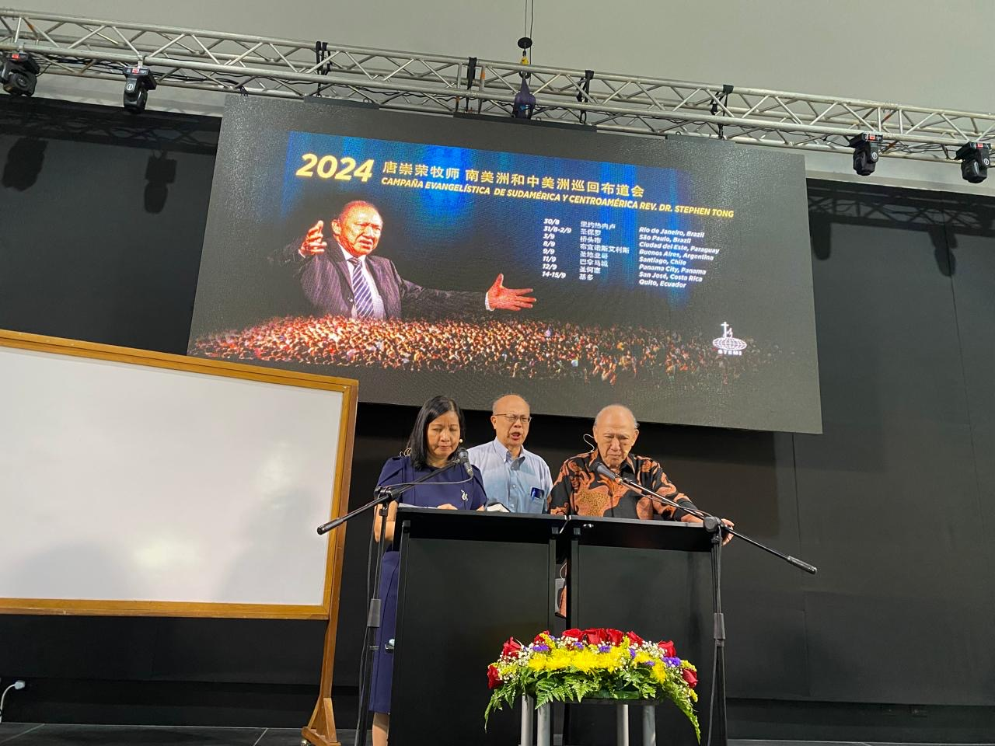
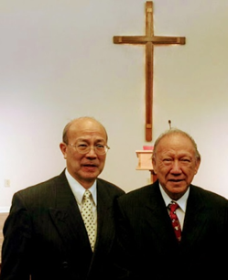
6. 宣告使徒行傳異象
6. Proclaim the vision of Acts continuing
Church experienced revival. A university was built. The goal of having 2,000 missionaries/10,000 co-workers were reached.
Acts Is God’s words, nothing can add to it. Nevertheless, Holy Spirit continues working under the same principle to advance the Kingdom of God, therefore, no one can stop it.
教會建立大學，2000宣教士/10000同工的大復興。
這並不是說聖經可以增添，乃是認定聖靈繼續作工，沒有人可以禁止。

Slide 36
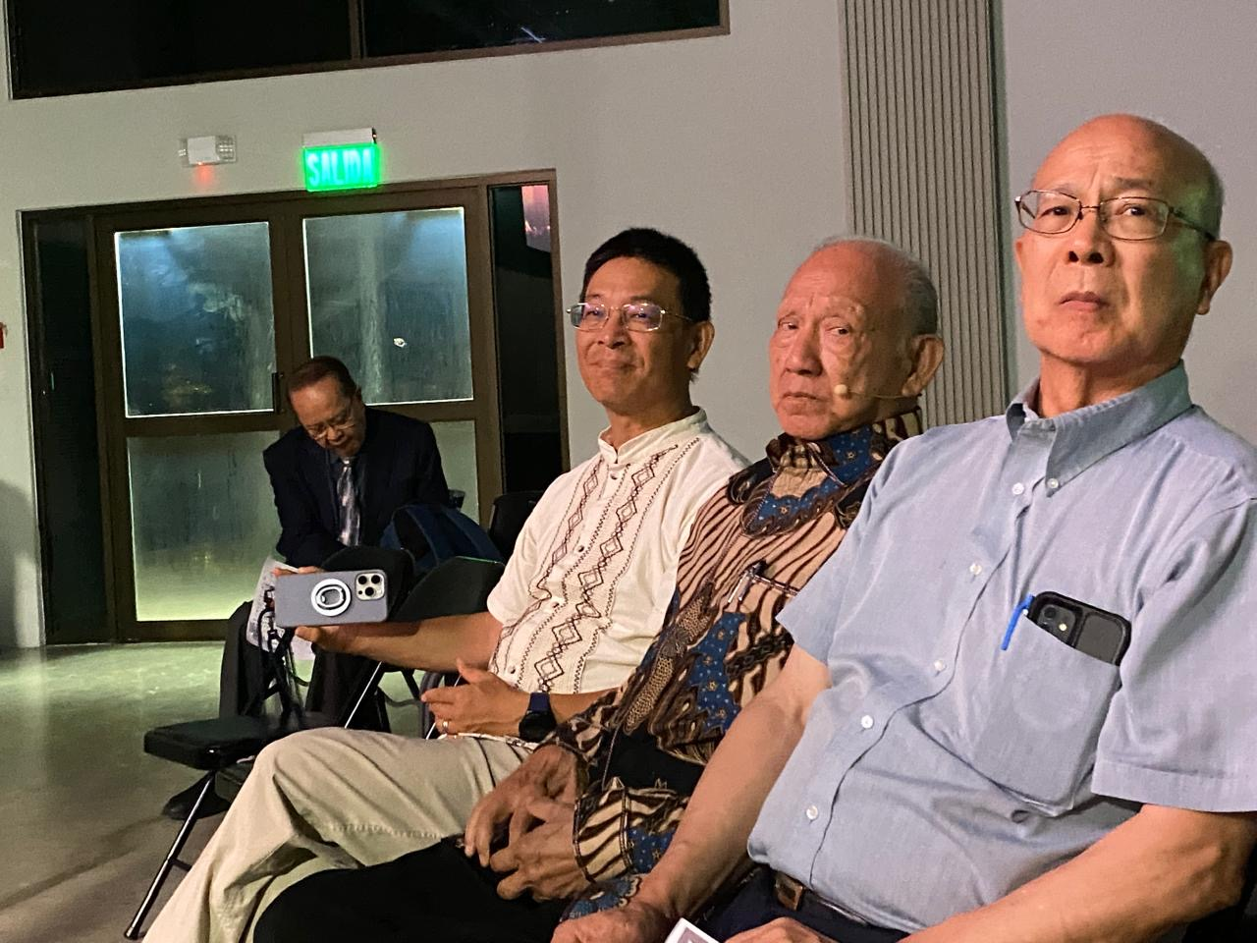
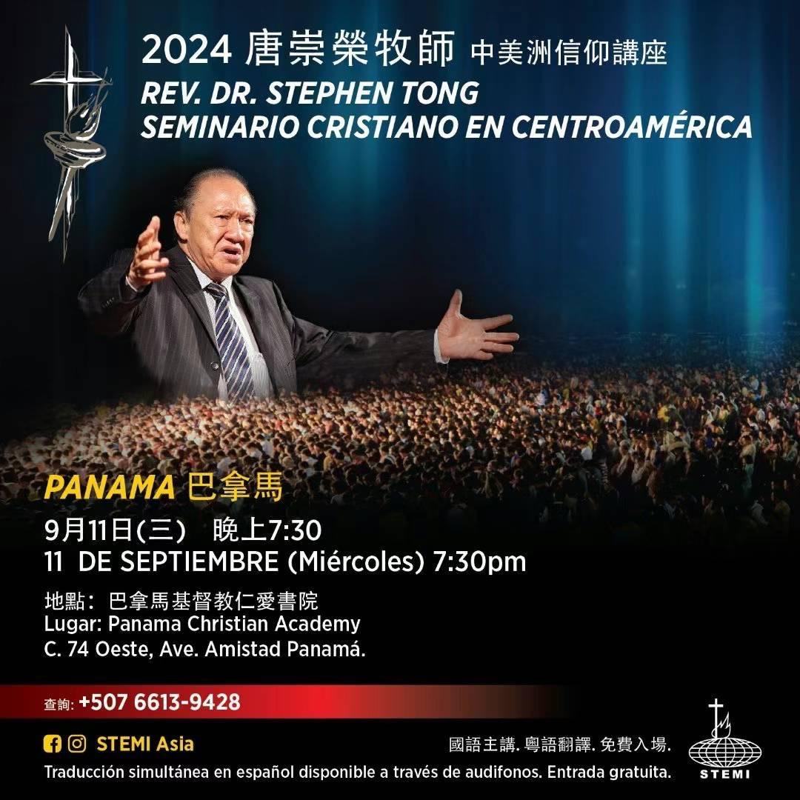
7. 成為一粒麥子
7. A kernel of wheat died to produce many seeds
信心宣教帶來神蹟，使無變有，在神沒有難成的事。
人人都參與宣教，向自己死，向神活。
Faith in mission leads to miracle . Nothing is impossible with God, who is the creator of the universe.
God called all to participate in Mission. Therefor let us die to self, and live for God.

Slide 37
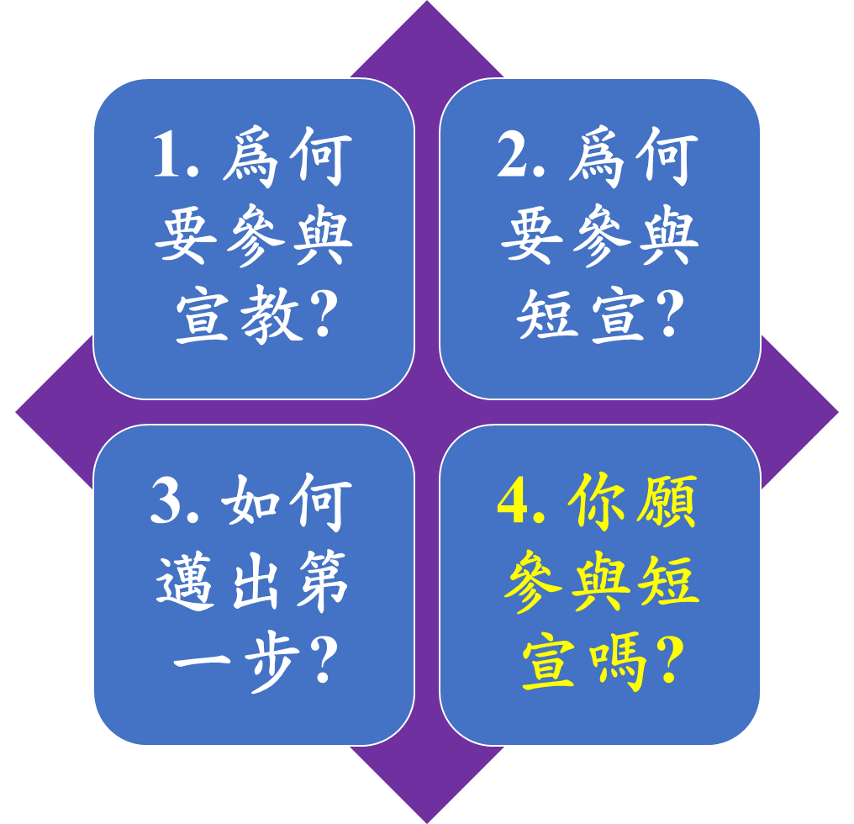
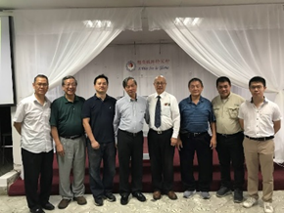
參與短期宣教
Take a Short Term Mission Trip
1. Why Mission?
2. Why Short Term Mission?
3. How to Take first Step?
4. Are You Willing to Take a Short Term Mission Trip?

Slide 38
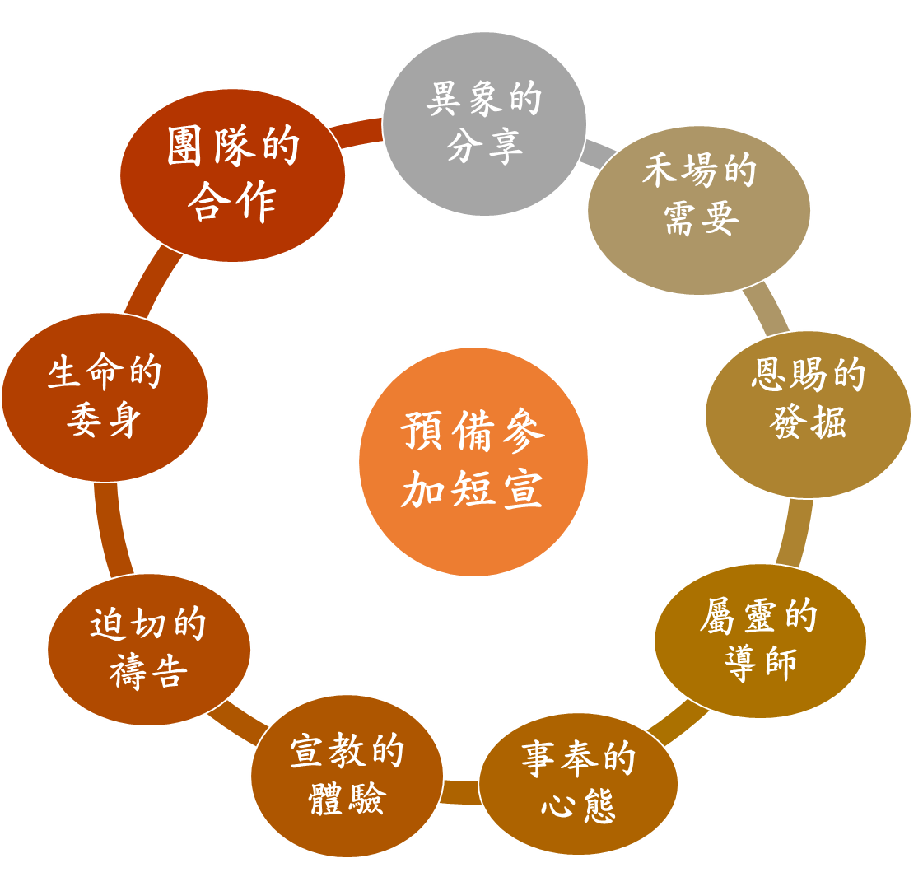
預備參加短宣
Steps to Prepare for ST Mission
STM
Vision
Prayer
Commitment
Team Work
Needs
Mentor
Attitude
Action
Gifts

Slide 39
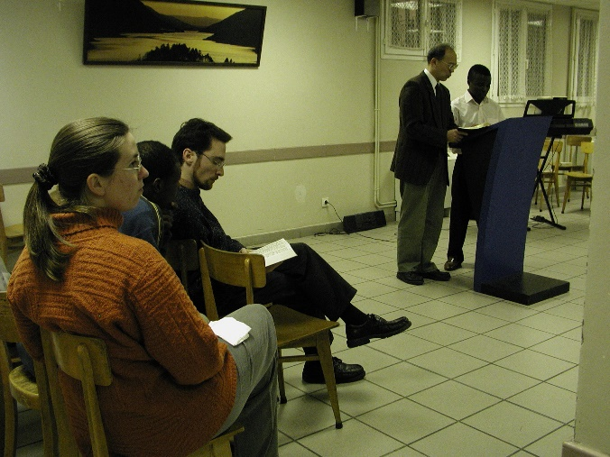
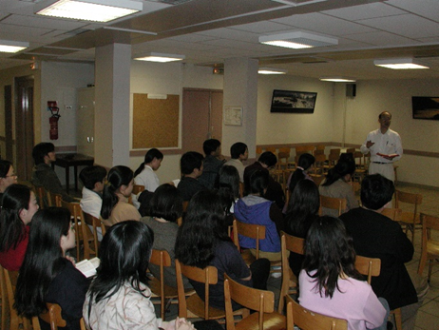
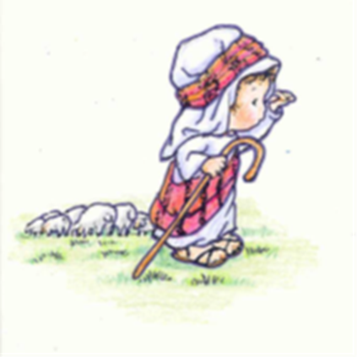
1. 異象的分享
1. Share Vision
人人都需要聽見福音
People need to hear Gospel

Slide 40
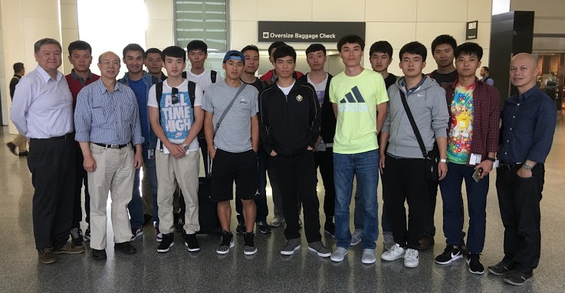
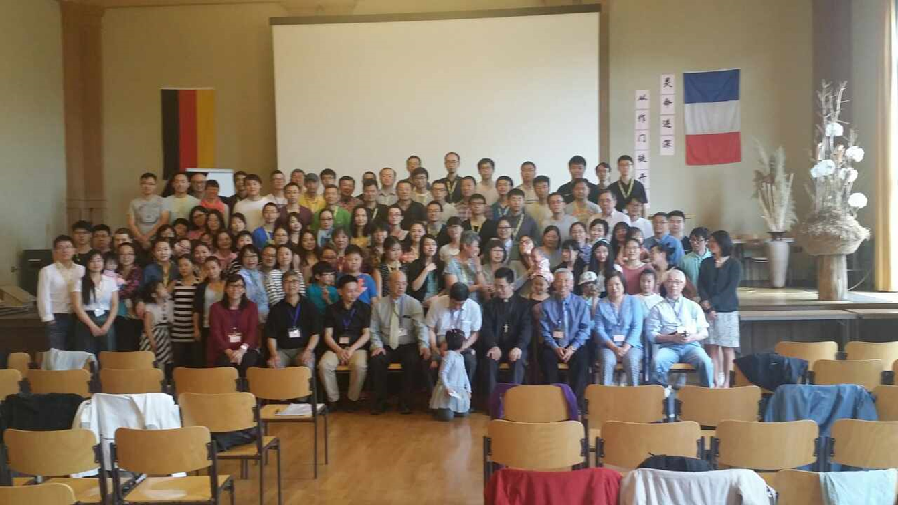
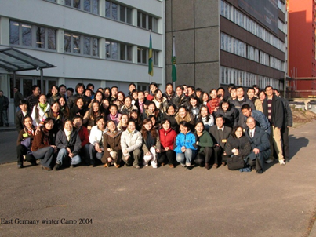
2. 禾場的需要
2. Harvest is plenty
當收的莊稼多作工的人少。(太9:37)
The harvest is plentiful but the workers are few. (Matthew 9:37)

Slide 41
3. 恩賜的發掘
3. Use Spiritual Gifts to serve others
操練所得的恩賜造就別人
Serve and equip others with the spiritual gifts

Slide 42
4. 屬靈的導師
4. Mentor
生命恩賜品格能力的導師
Mentor others with power and character

Slide 43
5. 事奉的心態
5. To serve with a humble attitude
謙卑義務事奉有需要的人
Humbly serve the needed

Slide 44
6. 宣教的體驗
6. Explore mission field
6. 宣教的體驗
憐憫人困苦流離像羊沒有牧人一般
People were harassed and helpless like sheep without a shepherd

Slide 45
7. 迫切的禱告
7. Pray for the lost souls in South America
情詞迫切的直求(路11:8)
Fervent prayer is much needed(Luke11:8)

Slide 46
8. 緬甸雙文化宣教士委身
8. Myanmar Trained bi-cultural missionary
撇下一切背十字架跟隨主

Slide 47
9. 團隊的合作
肢體相顧配搭事奉服事眾人

Slide 48
你願參與短宣嗎?
Do you desire to be equipped for a mission trip?
屬天的看見與行動
Spiritual vision and action are both needed

Slide 49
參與宣教的九項範圍
9 areas you may participate in Mission
Financial Supporter
Prayer Partner
Caring for missionary
Sponsor and
Consultant
Teacher to Missionary
Short Term
Mission
Bivocational
Missionary
Career
Missionary
Local
Missionary

Slide 50
參與短宣選項的兩個提醒
目標明確: 九個選項中你選了幾項?
運用靈活:願意完全順服聖靈的帶領嗎?

Slide 51
參與短宣的九個步驟
9 steps to participate in Short Term Mission
參與短宣
異象分享
迫切禱告
生命委身
團隊合作
禾場需要
屬靈導師
事奉心態
宣教體驗
恩賜發掘

Slide 52
參與短宣步驟的兩個問題
Two questions about participation in STM
Clear goal:
How many steps among those 9 have you experienced ?
Flexibility in actions:
Are you willing to allow Holy Spirit to lead you all the way?
目標明確:
九個步驟中你經歷了幾步?
運用靈活:
願意接受聖靈進一步的帶領嗎?

Slide 53
青少年英語事工
Youth and English Ministry
德州青少年的服事
Children and Youth Ministry

Slide 54
支持佈道培靈會
Support global evangelistic meetings
唐崇榮博士佈道大會
Support Dr. Stephen Tong Evangelistic Rally

Slide 55
跨文化宣教
Cross Culture Mission in Evangelism
服事法國當地人的教會
Serve local people in France

Slide 56
中東大戰隨時可升級
Conflict in Mideast could escalate to world war
Rising tensions have the potential to trigger an all-out war between Israel and Hezbollah.
以色列與阿拉伯國家的戰爭已成常態

Slide 57
緬訓成立於 1982年
緬福成立於 1985年
使命
使命
緬甸基督教傳道人訓練學院（簡稱緬訓）
訓練按正意分解真理的道，
去傳揚耶穌基督的福音，
做又忠心、又良善的僕人；去建立基督的教會，
使人受益，榮耀神的聖名。
，
緬甸基督福音宣教會
（簡稱緬福）
向不同城市和鄉村的萬民傳福音，宣教植堂。蒙聖靈感動得以認識創造天地萬物的父神；並悔改相信神所設立的救主耶穌基督，罪得赦免、獲得永生。 ，

Slide 58
善用媒體傳信息
Build Vital Media Ministry
服事的方式不同，要竭力繼續長進。
114講道系列中，目前排名第一。
CGNTV講道系列點擊順序鏈接:
http://chinese.cgntv.net/category.php?template_file=&category=1031&search_category1=&search_category2=&search_category3=&sort=inquire_desc
Diversified growing ministry.
CGNTV 114 Preaching Series, No.1.
CGNTV website linkage:
http://chinese.cgntv.net/category.php?template_file=&category=1031&search_category1=&search_category2=&search_category3=&sort=inquire_desc

Slide 59
聯繫方式
種好種網頁 https://sowgoodseeds.org
訓練資料 www.jamessun.net
電郵聯繫 _james_c_sun@yahoo.com
Line: jimcsun
電話: 510 825-8842
Contact Information
Sow Good Seeds Website https://sowgoodseeds.org
Mentor www.jamessun.net
Email
james_c_sun@yahoo.com
Line: jimcsun
Phone: 510 825-8842

Slide 60
突破一切的攔阻
願神祝福大家
我們同心禱告
Mission Breakthrough
God bless you
Shall we pray

